Slide 1
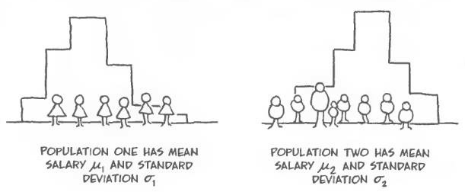
Independent Samples T-Test
Chapter 8 Part 2
Dr. Abolfazl Saghafi
Assistant Professor of Statistics & Data Science
Data Science Program Director
Notes:
Testing for two independent means

Slide 2
Independent Vs Dependent
Two samples are independent if the sample values selected from one population are not related to or somehow paired with the sample values selected from the other population.
Ex: One group of subjects is treated with the cholesterol reducing
drug Lipitor, while a second and separate group of subjects is given a placebo.
Two samples are dependent if the members of one sample are paired with the members of the other sample or measurements are gathered for one individual at two different stages.
Ex: The effectiveness of a diet is tested using weights of subjects measured before and after the diet treatment.

Slide 3


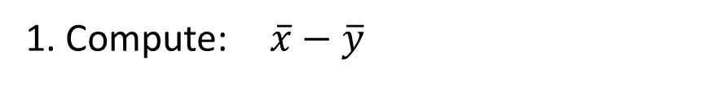
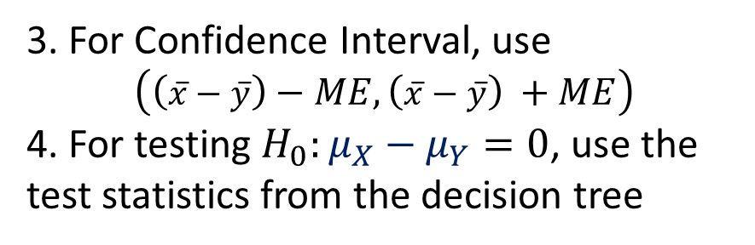

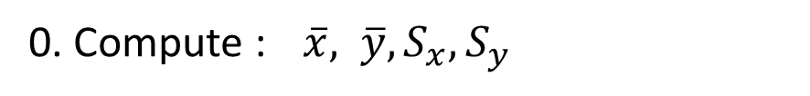
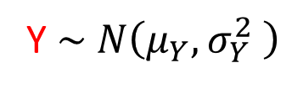

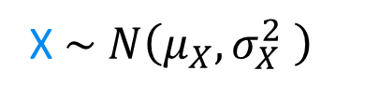

Independent Samples
Population 1
Variable of interest: X
Population 2
Variable of interest: Y
Examples include:
* Control & Treatment Groups
*
X $\sim N\left(μ_{X},σ_{X}^{2} \right)$
Y $\sim N\left(μ_{Y},σ_{Y}^{2} \right)$
0. Compute : $\overline{x}, \overline{y}, S_{x}, S_{y}$
Unknown
1. Compute: $\overline{x}−\overline{y}$
We are interested in inference on the difference $μ_{X}−μ_{Y}$
2. Use the decision tree to determine your population type, ME and test statistics
$$⇓$$
$$⇓$$
Sample of size n
Sample of size m
3. For Confidence Interval, use
$$\left(\left(\overline{x}−\overline{y}\right)−ME,\left(\overline{x}−\overline{y}\right) +ME\right)$$
4. For testing $H_{0}:μ_{X}−μ_{Y}=0$, use the test statistics from the decision tree
$$x_{1},x_{2},…,x_{n}$$
$$y_{1},y_{2},…,y_{m}$$
Notes:
If the two distributions are not known BUT both sample sizes are greater than 30, we can still use the procedure

Slide 4
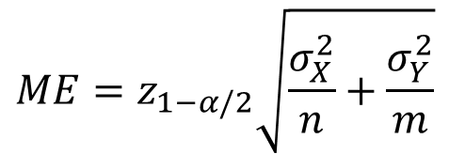
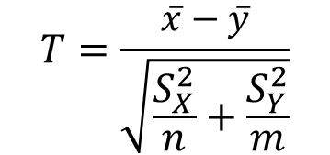

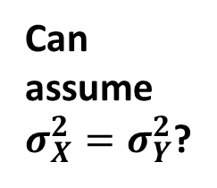
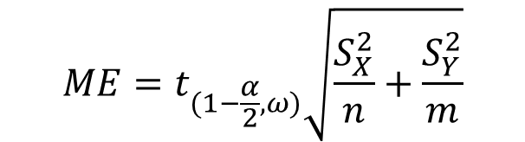
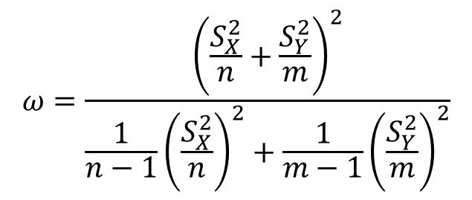
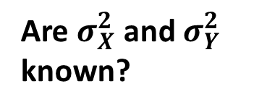
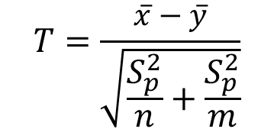
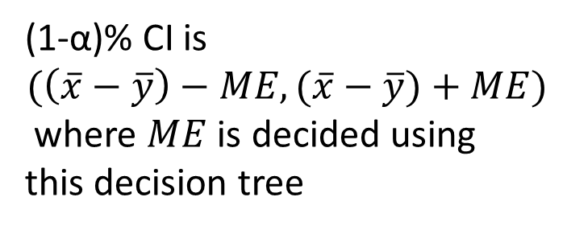
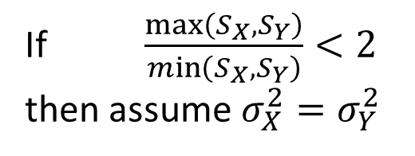
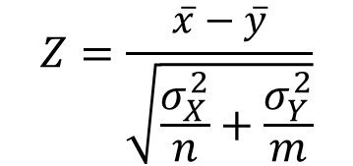
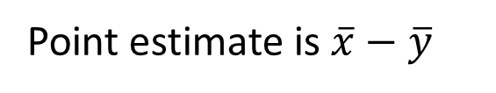
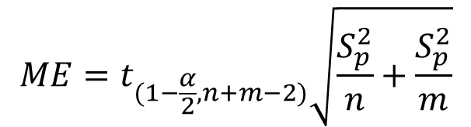
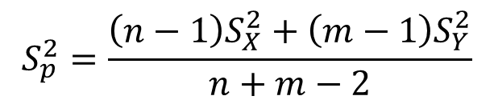
Inference for $μ_{X}−μ_{Y}$
For CI
For Testing
$$ME=z_{1−α/2}\sqrt{\frac{σ_{X}^{2}}{n}+\frac{σ_{Y}^{2}}{m}}$$
I
$$Z=\frac{\overline{x}−\overline{y}}{\sqrt{\frac{σ_{X}^{2}}{n}+\frac{σ_{Y}^{2}}{m}}}$$
Point estimate is $\overline{x}−\overline{y}$
(1-α)% CI is
$$(\left(\overline{x}−\overline{y}\right)−ME,(\overline{x}−\overline{y})+ME)$$
where $ME$ is decided using
this decision tree
$$ME=t_{(1−\frac{α}{2},n+m−2)}\sqrt{\frac{S_{p}^{2}}{n}+\frac{S_{p}^{2}}{m}}$$
$$T=\frac{\overline{x}−\overline{y}}{\sqrt{\frac{S_{p}^{2}}{n}+\frac{S_{p}^{2}}{m}}}$$
II
Yes
Yes
Are $σ_{X}^{2}$ and $σ_{Y}^{2}$ known?
Can assume $σ_{X}^{2}=σ_{Y}^{2}$?
$$ME=t_{(1−\frac{α}{2},ω)}\sqrt{\frac{S_{X}^{2}}{n}+\frac{S_{Y}^{2}}{m}}$$
$$T=\frac{\overline{x}−\overline{y}}{\sqrt{\frac{S_{X}^{2}}{n}+\frac{S_{Y}^{2}}{m}}}$$
No
No
$$S_{p}^{2}=\frac{\left(n−1\right)S_{X}^{2}+\left(m−1\right)S_{Y}^{2}}{n+m−2}$$
III
$$ω=\frac{{\left(\frac{S_{X}^{2}}{n}+\frac{S_{Y}^{2}}{m}\right)}^{2}}{\frac{1}{n−1}{\left(\frac{S_{X}^{2}}{n}\right)}^{2}+\frac{1}{m−1}{\left(\frac{S_{Y}^{2}}{m}\right)}^{2}}$$
If $\frac{\max\left(S_{X},S_{Y}\right)}{\min\left(S_{X},S_{Y}\right)}<2$
then assume $σ_{X}^{2}=σ_{Y}^{2}$

Slide 5

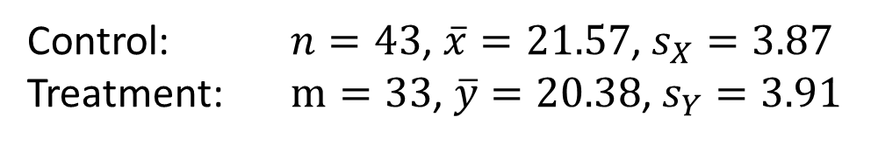
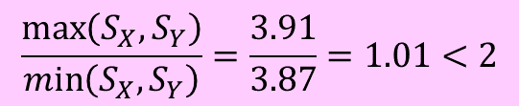
Ex1. Bipolar Depression
In an experiment designed to test the effectiveness of paroxetine
for treating bipolar depression, subjects with bipolar depression were put into either control or treatment group. People in treatment group received paroxetine while in control group received fake pills. Their level of depression was then measured using the Hamilton Depression Scale with the following summary.
Use a 0.05 significance level to test the claim that treatment and placebo groups have different mean Hamilton depression score. What does the result of the hypothesis test suggest about paroxetine as a treatment for bipolar depression?
Control: $n=43$, $\overline{x}=21.57$, $s_{X}=3.87$
Treatment: $m=33$, $\overline{y}=20.38$, $s_{Y}=3.91$
$$\frac{\max\left(S_{X},S_{Y}\right)}{\min\left(S_{X},S_{Y}\right)}=\frac{3.91}{3.87}=1.01<2$$
Notes:
X: Hamilton Depression Score for people in Control group ~ N($μ_{X}$,σx)
Y: Hamilton Depression Score for people in Treatment group ~ N($μ_{Y}$,σy)
We want to test if Mean Hamilton Depression Score in the Control group ($μ_{X}$) is the same ($=$) or different ($≠$) from Mean Hamilton Depression Score in the Treatment group ($μ_{Y}$). That is we would like to test if $μ_{X}=μ_{Y}$ versus the alternate of $μ_{X}≠μ_{Y}$.
Note: if you’d like to test whether treatment decreases the depression scores, then you’re alternate would be $μ_{X}>μ_{Y}$

Slide 6
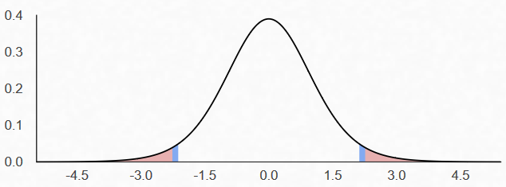

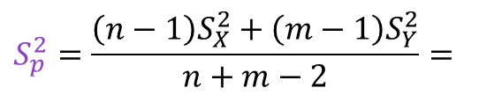
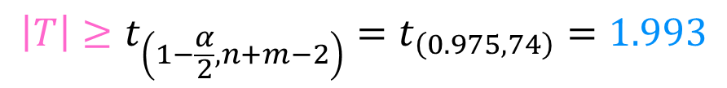
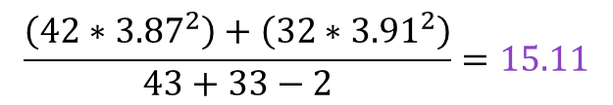
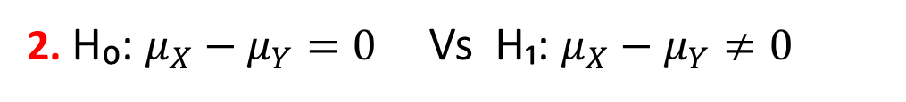
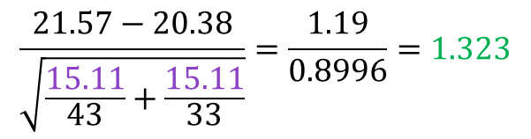
0. $σ_{X}^{2}$ and $σ_{Y}^{2}$ are unknown but we can assume $σ_{X}^{2}=σ_{Y}^{2}$ => Population type is II
1. α = 0.05
2. H₀: $μ_{X}−μ_{Y}=0$ Vs H₁: $μ_{X}−μ_{Y}≠0$
3. Test Statistic:
$$T=\frac{\overline{x}−\overline{y}}{\sqrt{\frac{S_{p}^{2}}{n}+\frac{S_{p}^{2}}{m}}}=$$
$$\frac{21.57−20.38}{\sqrt{\frac{15.11}{43}+\frac{15.11}{33}}}=\frac{1.19}{0.8996}=1.323$$
$$S_{p}^{2}=\frac{\left(n−1\right)S_{X}^{2}+\left(m−1\right)S_{Y}^{2}}{n+m−2}=$$
$$\frac{\left(42∗{3.87}^{2}\right)+\left(32∗{3.91}^{2}\right)}{43+33−2}=15.11$$
4. Rejection Region:
$$\left|T\right|≥t_{\left(1−\frac{α}{2},n+m−2\right)}=t_{\left(0.975,74\right)}=1.993$$
5. T = 1.323 is NOT in the rejection region, H₀ is NOT rejected
6. At 5% level of significance there is insufficient evidence to reject the null hypothesis and the drug is not effective.

Slide 7

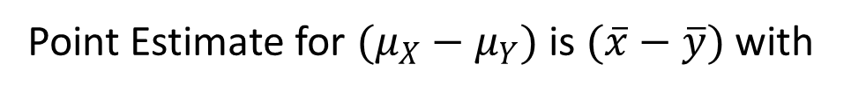

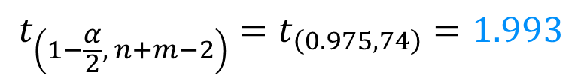

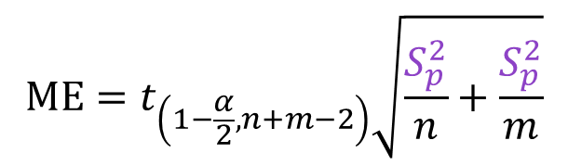
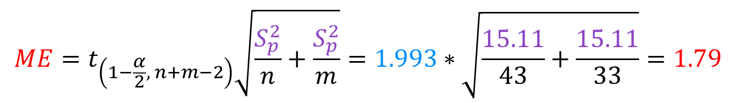
Same conclusion can be made using Confidence Interval for DIFFERENCE:
Point Estimate for $(μ_{X}−μ_{Y})$ is $(\overline{x}−\overline{y})$ with
$$ME=t_{\left(1−\frac{α}{2}, n+m−2\right)}\sqrt{\frac{S_{p}^{2}}{n}+\frac{S_{p}^{2}}{m}}$$
$$t_{\left(1−\frac{α}{2}, n+m−2\right)}=t_{\left(0.975,74\right)}=1.993$$
where $S_{p}^{2}=\frac{\left(n−1\right)S_{X}^{2}+\left(m−1\right)S_{Y}^{2}}{n+m−2}=\frac{\left(42∗{3.87}^{2}\right)+\left(32∗{3.91}^{2}\right)}{43+33−2}=15.11$
Then CI is
$$\left(\overline{x}−\overline{y}\right)±ME$$
$$ME=t_{\left(1−\frac{α}{2}, n+m−2\right)}\sqrt{\frac{S_{p}^{2}}{n}+\frac{S_{p}^{2}}{m}}=1.993∗\sqrt{\frac{15.11}{43}+\frac{15.11}{33}}=1.79$$
Since the interval includes value of zero, we are 95% confident that the treatment is not effective.
$$(21.57−20.38)±1.72$$
$${(−0.60, 2.98)}_{95\%}$$
Notes:
IF you were asked to build a confidence interval for difference between Hamilton depression scores in the Control and Treatment group, this slides shows how to do that.
Follow up calculations of t and $S_{p}^{2}$ on last slide if you’re struggling

Slide 8
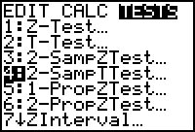


Using Calculator
Press STAT and the right arrow twice to select TESTS.
Depending on the case type, select 3: 2-SampleZTest (Case I) or
4: 2-SampleTTest (Case II and III) Press ENTER.
If you have your data entered in columns, select Data.
If you don’t, select Stats and enter the required values.
Select the type of alternate hypothesis
If This is Case II, then select pooled YES, otherwise No
Hit Calculate
Notes:
This is the process for testing two independent samples

Slide 9

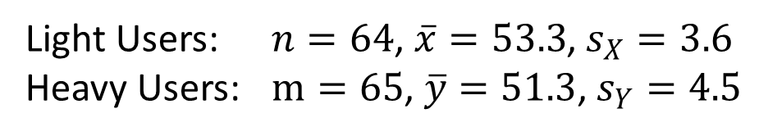
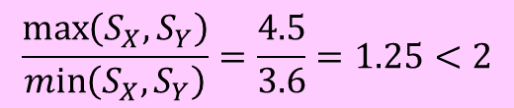
Ex2. Effect of Marijuana Use
Many studies have been conducted to test the effects of marijuana use on mental abilities. In one such study, groups of light and heavy users of marijuana in college were tested for memory recall, with the results given below [1].
Use a 0.01 significance level to test the claim that the population of heavy marijuana users has a lower memory recall than the light users.
Should marijuana use be of concern to college students?
Light Users: $n=64$, $\overline{x}=53.3$, $s_{X}=3.6$
Heavy Users: $m=65$, $\overline{y}=51.3$, $s_{Y}=4.5$
$$\frac{\max\left(S_{X},S_{Y}\right)}{\min\left(S_{X},S_{Y}\right)}=\frac{4.5}{3.6}=1.25<2$$
[1] Pope and Yurgelun-Todd, The Residual Cognitive Effects of Heavy Marijuana Use in College Students, Journal of the American Medical Association, Vol. 275, No. 7.
Notes:
X: Memory recall test score for light marijuana users ~ N($μ_{X}$,σx)
Y: Memory recall test score for heavy marijuana users ~ N($μ_{Y}$,σy)
We would like to test whether mean memory recall scores in light marijuana users ($μ_{X}$) is the same ($=$) or greater than ($>$) mean memory recall scores in heavy marijuana users ($μ_{Y}$)

Slide 10
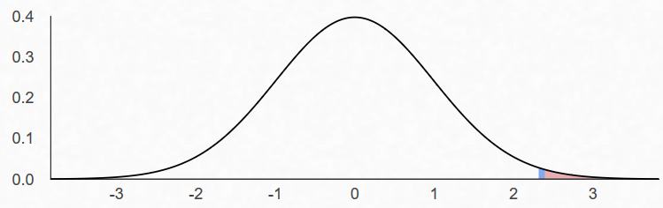
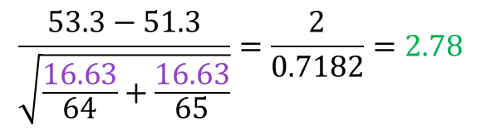

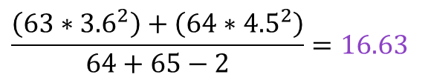

0. $σ_{X}^{2}$ and $σ_{Y}^{2}$ are unknown but we can assume $σ_{X}^{2}=σ_{Y}^{2}$ => Population type is II
1. α = 0.01
2. H₀: $μ_{X}−μ_{Y}=0$ Vs H₁: $μ_{X}−μ_{Y}>0$
3. Test Statistic:
$$T=\frac{\overline{x}−\overline{y}}{\sqrt{\frac{S_{p}^{2}}{n}+\frac{S_{p}^{2}}{m}}}=$$
$$\frac{53.3−51.3}{\sqrt{\frac{16.63}{64}+\frac{16.63}{65}}}=\frac{2}{0.7182}=2.78$$
$$S_{p}^{2}=\frac{\left(n−1\right)S_{X}^{2}+\left(m−1\right)S_{Y}^{2}}{n+m−2}=$$
$$\frac{\left(63∗{3.6}^{2}\right)+\left(64∗{4.5}^{2}\right)}{64+65−2}=16.63$$
4. Rejection Region:
$$T≥t_{\left(1−α,n+m−2\right)}=t_{\left(0.99,127\right)}=2.356$$
5. T = 2.78 IS in the rejection region, H₀ is rejected
6. At 1% level of significance there is sufficient evidence to reject the null hypothesis and conclude that heavy marijuana users have lower recall test scores.
Notes:
Confidence interval is not useful here since alternate hypothesis is not two sided
P-Value = P(T127≥2.78)=tcdf(2.78,99,127)=0.0031
P-value is less than α = 0.01 therefore, we have evidence to reject the null hypothesis at 1% significance level

Slide 11

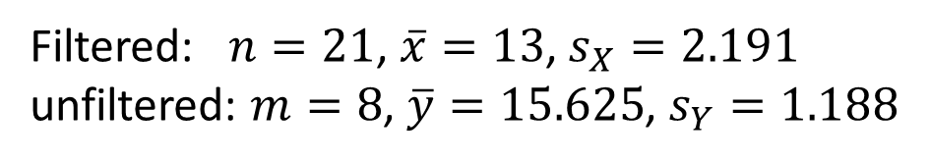
Ex3. Carbon Monoxide and Cigarettes
The following data shows measured amounts of carbon monoxide (CO) from samples of filtered and unfiltered king-size cigarettes in mg [1].
Use a 0.05 significance level to test the claim that the mean amount of carbon monoxide in filtered king-size cigarettes is less than the mean amount of carbon monoxide for unfiltered king-size cigarettes. Based on this result, are cigarette filters effective in reducing carbon monoxide? Assume normal population.
Filtered: 14, 12, 14, 16, 15, 8, 14, 16, 11, 13,
13, 11, 12, 12, 13, 14, 13, 14, 9, 17, 12
Unfiltered: 14 15 17 17 16 16 14 16
Filtered: $n=21$, $\overline{x}=13$, $s_{X}=2.191$
unfiltered: $m=8$, $\overline{y}=15.625$, $s_{Y}=1.188$
[1] Federal Trade Commission.
Notes:
Enter the numbers into two different columns in the calculator and get their summary values separately using STAT > CALC > 1-Var Stats, write down these THREE summary values for each set of data: (sample size, sample mean, sample standard deviation). Using these values, follow the same 6-step process to perform a testing. You can do the whole process using the calculator to check your answers.
X: CO in filtered cigarettes ~ N($μ_{X}$,σx) Y: CO in unfiltered cigarettes ~ N($μ_{Y}$,σy)
We would like to test whether mean CO in filtered cigarettes ($μ_{X}$) is the same ($=$) or less than ($<$) mean CO in unfiltered cigarettes ($μ_{Y}$)

Slide 12
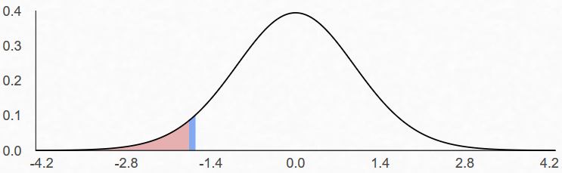

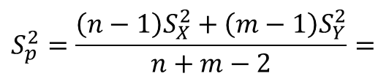
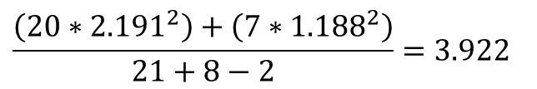

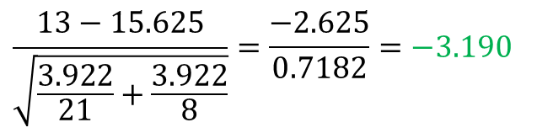
0. $σ_{X}^{2}$ and $σ_{Y}^{2}$ are unknown but we can assume $σ_{X}^{2}=σ_{Y}^{2}$ => Population type is II
1. α = 0.05
2. H₀: $μ_{X}−μ_{Y}=0$ Vs H₁: $μ_{X}−μ_{Y}<0$
3. Test Statistic:
$$T=\frac{\overline{x}−\overline{y}}{\sqrt{\frac{S_{p}^{2}}{n}+\frac{S_{p}^{2}}{m}}}=$$
$$\frac{13−15.625}{\sqrt{\frac{3.922}{21}+\frac{3.922}{8}}}=\frac{−2.625}{0.7182}=−3.190$$
$$S_{p}^{2}=\frac{\left(n−1\right)S_{X}^{2}+\left(m−1\right)S_{Y}^{2}}{n+m−2}=$$
$$\frac{\left(20∗{2.191}^{2}\right)+\left(7∗{1.188}^{2}\right)}{21+8−2}=3.922$$
4. Rejection Region:
$$T≤−t_{\left(1−α,n+m−2\right)}=−t_{\left(0.95,27\right)}=−invT(0.95,27)=−1.170$$
5. T = -3.19 IS in the rejection region, H₀ is rejected
6. At 5% level of significance there is sufficient evidence to reject the null hypothesis and conclude that filtered cigarettes have a significantly lower mean CO
Notes:
0. $\frac{s_{X}}{s_{Y}}=\frac{2.191}{1.188}=1.844<2$, therefore se can assume that $σ_{X}^{2}=σ_{Y}^{2}$
Confidence interval is not useful here since alternate hypothesis is not two sided
P-Value = P(T27≤-3.190)=tcdf(-99,-3.19,27)=0.00179
P-value is less than α = 0.05 therefore, we have evidence to reject the null hypothesis at 5% significance level

Slide 13
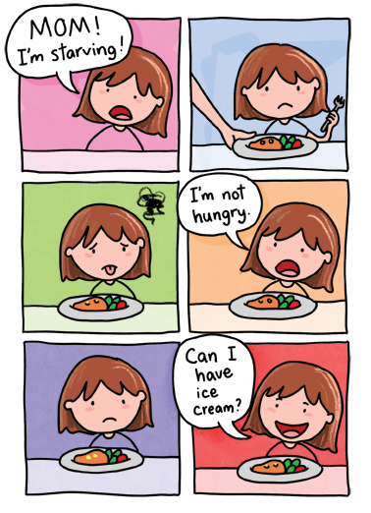
Ex4. Ice Cream and Fat
The following are percentages of fat found in 5 randomly selected samples of each of two brands of ice cream:
Brand A: 5.7 4.5 6.2 6.3 7.3
Brand B: 6.3 5.7 5.9 6.4 5.1
Assume that the percentage of fat in the two brands of ice cream follows a Normal distribution. Do we have sufficient evidence to conclude that the two brands have different mean fat content?
If you’re fluffiophobic, don’t worry, the numbers are made up!

Slide 14


Practice Problems Part 2
1. Sample data were collected in a study of calcium supplements and their effects on blood pressure. A placebo group and a calcium group began the study with blood pressure [1].
At the 0.05 significance level, test the claim that the two sample groups come from populations with the same mean. If the experiment requires groups with equal standard deviations, are these two groups acceptable?
Placebo: 124.6 104.8 96.5 116.3 106.1 128.8 107.2 123.1
118.1 108.5 120.4 122.5 113.6
Calcium: 129.1 123.4 102.7 118.1 114.7 120.9 104.4 116.3
109.6 127.7 108.0 124.3 106.6 121.4 113.2
[1] Lyle et al., Blood Pressure and Metabolic Effects of Calcium Supplementation in Normotensive White and Black Men, Journal of the American Medical Association, Vol. 257, No. 13.

Slide 15
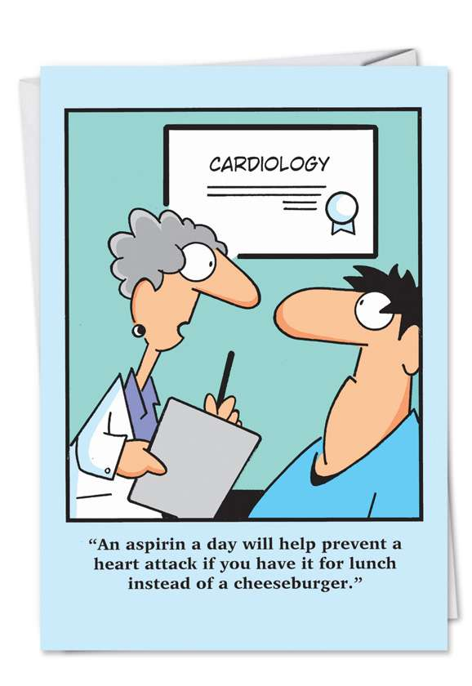
Practice Problems Part 2
2. Drug Company X claims its aspirin tablets will relieve headaches faster than any other aspirin on the market. To determine whether their claim is valid, two random samples of size 15 are chosen, from aspirins made by them and another drug company. An aspirin is given to each of the 30 randomly selected persons suffering from headaches and the number of minutes required for each to recover from the headache is recorded
Sample mean Sample variance
Company X 8.4 4.2
Company Y 8.9 4.6
Perform a test to determine whether company X aspirin cures headaches significantly faster than company Y.
Aspirin!
Again!!
Notes:
0. Population type is II
1. $α=0.05$
2. H0: $μ_{X}=μ_{Y}$ Vs H1: $μ_{X}<μ_{Y}$ where $μ$ is the mean headache relief time
3. Sp= T=-0.65
4. RR is T<=-invT(0.95,28)

